Slide 1
Confidential. For internal use only.

Slide 2
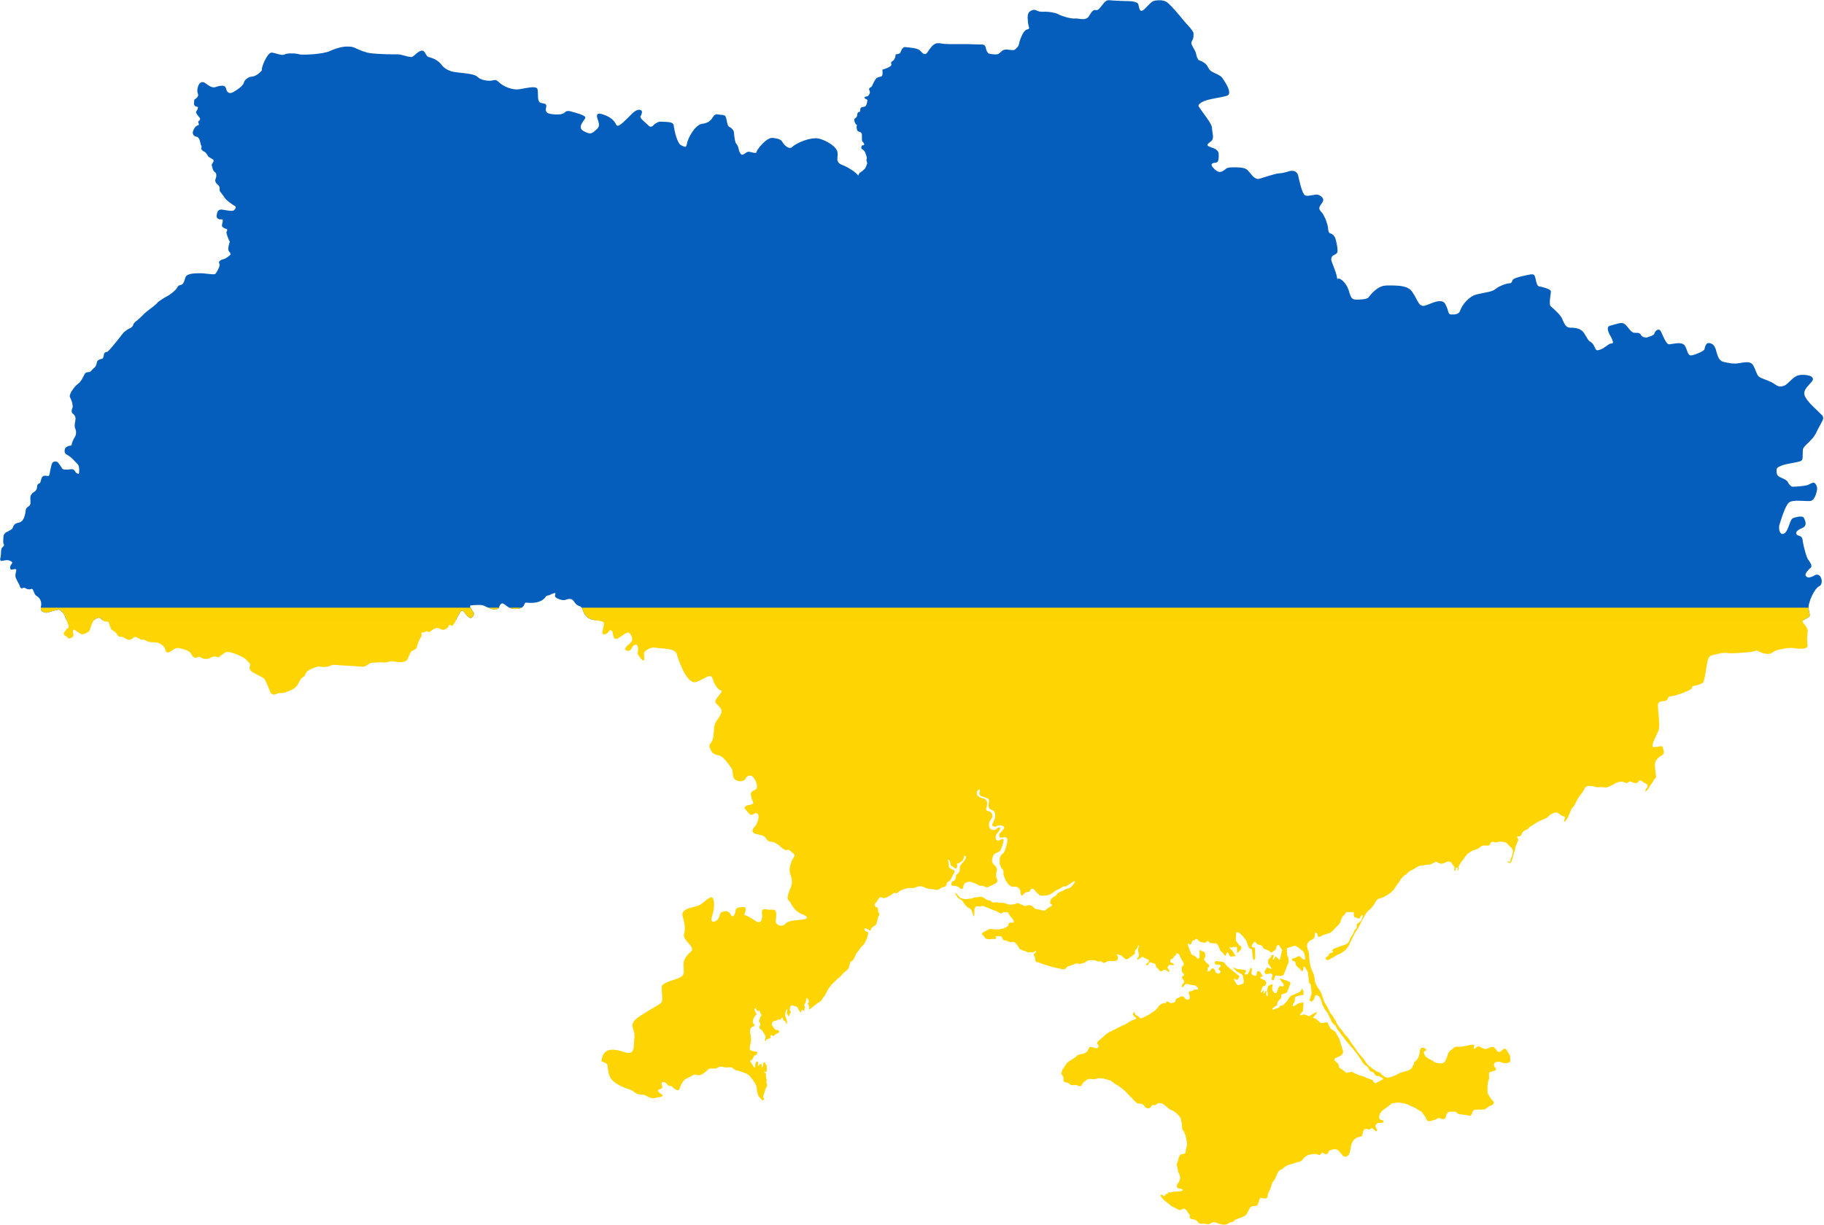
War caused the biggest migration in modern history
~8,2 mio are currently abroad
~5 mio registered as refugees in Europe
75% women with high education and kids
up to 50% have a job
ratio 1 working officially in Ukraine vs 1 refugee (or working) outside the country
41,2 mio before the War
< 65% wish to return back to Ukraine
> 30% ready to do it the nearest future
~13 mio affected by internal migration

Slide 3
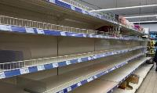
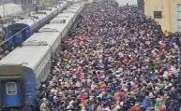
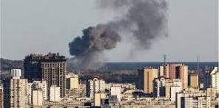
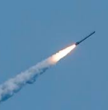
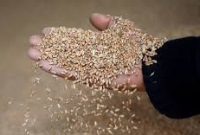
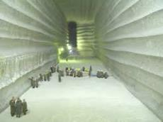
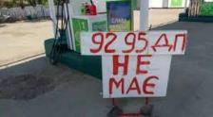
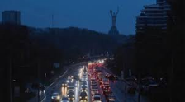
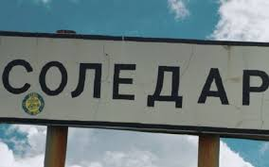
Different crises come one after another we have to adapt as we go
queues
Supply chain & Logistics disruption
Regular missile attacks, infrastructure distraction
Curfew
Closed sky, seaports
Blocked roads & boarder queues
143 bio $ direct losses estimation
700 bio $ total losses
10 regions are heavily impacted
Fuel & Energy Crisis, Blackouts
Risk of Food Crisis
5-20L per car fuel
12 hours per day electricity supply
Grain deal
1 sea tanker = 3 600 car tracks

Slide 4
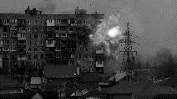
Consumer Confidence fully depended on Full scale war phases reaching highest ever with believe in our victory & territories liberation
Stabilization and Kharkiv region liberation
Liberation of North
Anticipation of Counteroffensive
Invasion
24.02.2022
Massive missile attacks and blackouts
Doubts and defeats
Before Invasion

Slide 5
But blackouts didn’t break our spirit: majority of Ukrainians are staying at home and believe in economy recovery after the war
Relocation intention due to blackout
Perception of war influence on UA
economics future
65% are not going to leave their home

Slide 6
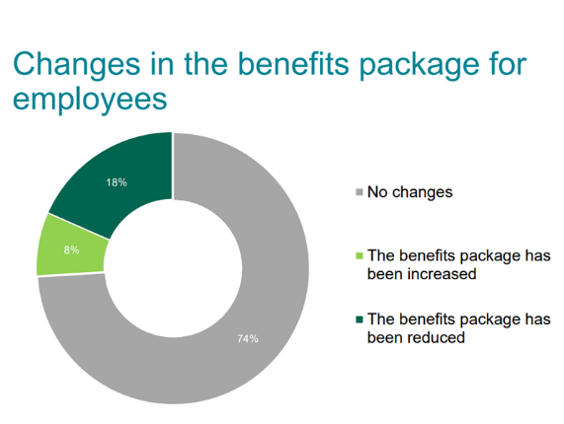
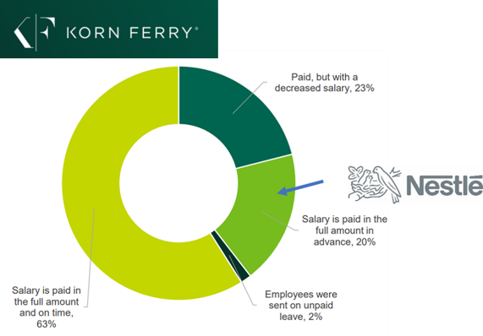
Majority of big FMCG companies kept paying to employees in full ensuring additional support
Changes in Salary
payment
Changes in the benefits package of employees

Slide 7
Local small and medium business had to respond to business activity reduction reviewing number of people and salaries
Still demonstrating strong ability to adapt:
58% companies changed or adapted service/product to new reality
50% are looking for customers outside Ukraine and 30% are already exporting goods and services
Source: UA Business Global study September 2022 (data comparing to pre-war period)

Slide 8
Ukraine: Macro Environment
GDP Growth Rate
Inflation Rate
Unemployment Rate
UAH Devaluation vs USD
8
30/05/23
SEE Business Review H1 – March 2023
Source: UkrStat; CITI, Treasury department

Slide 9
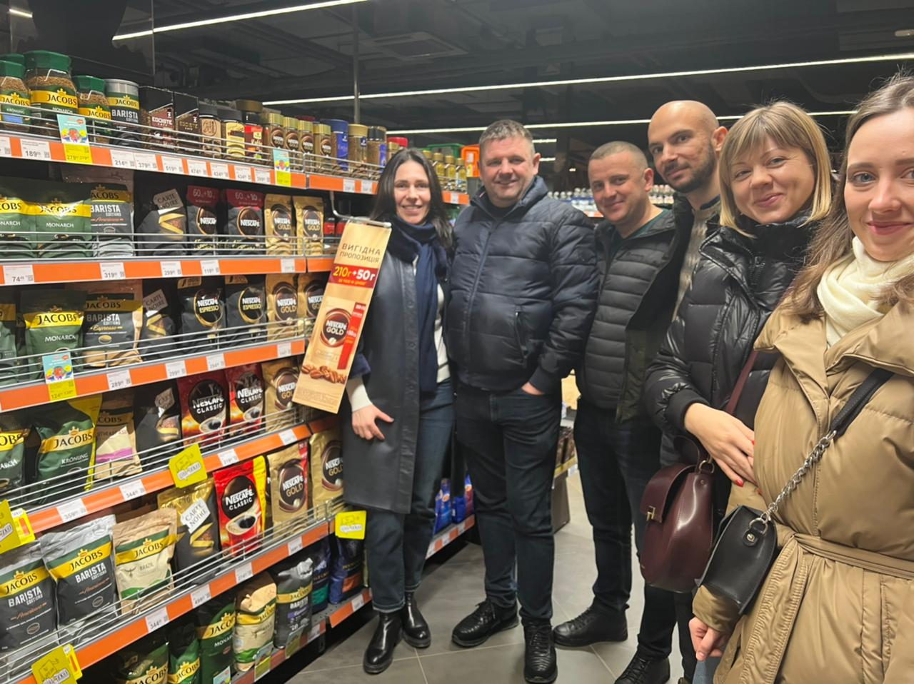
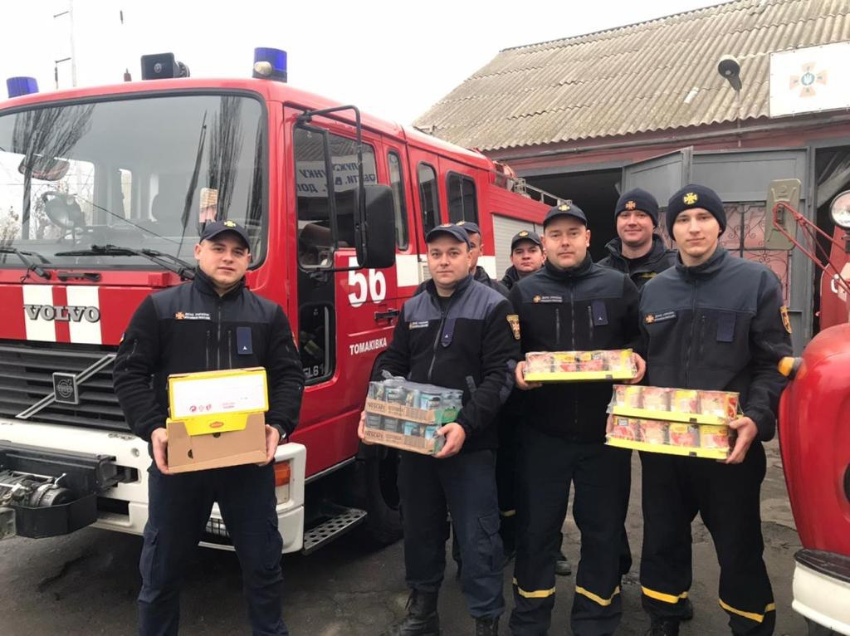
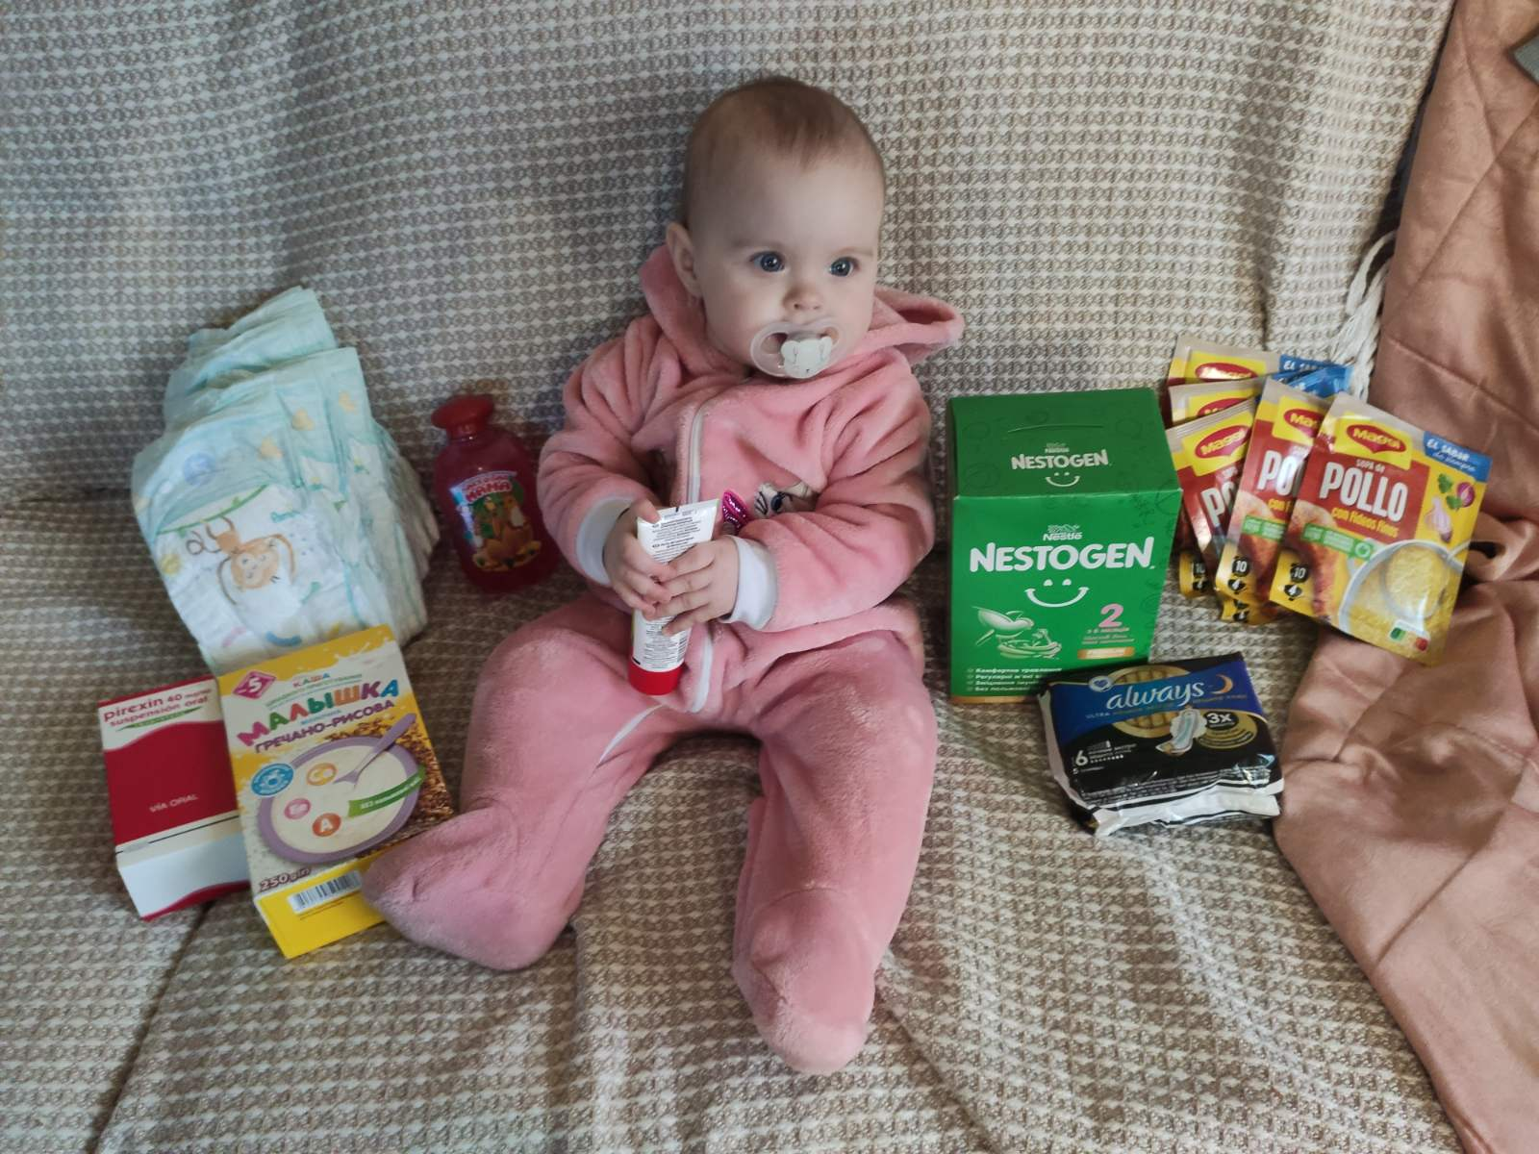
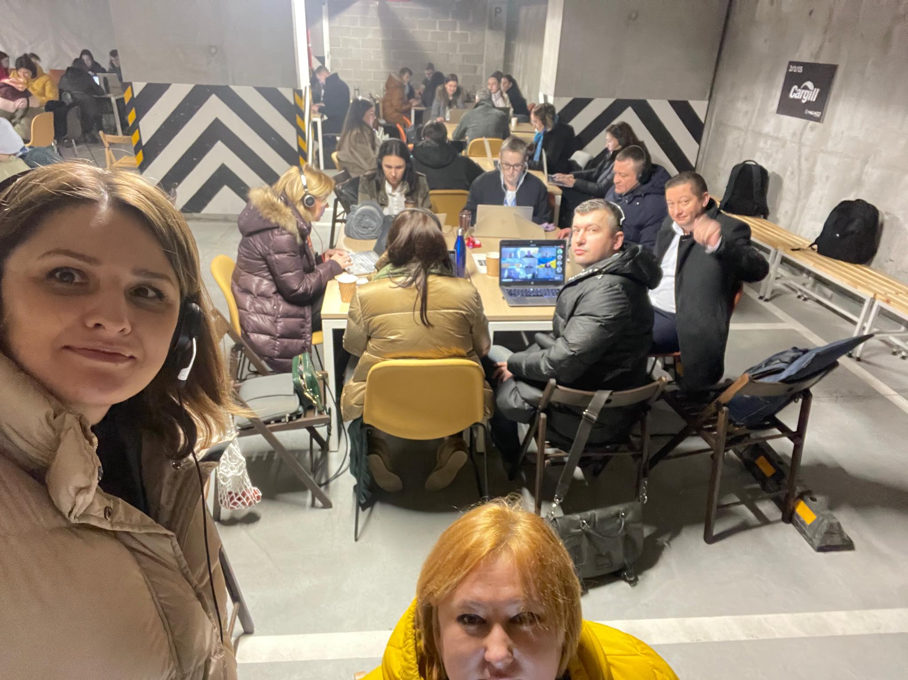
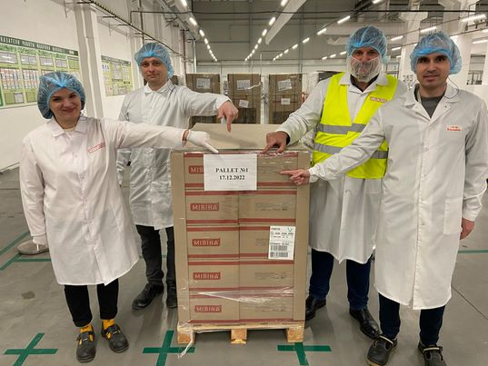
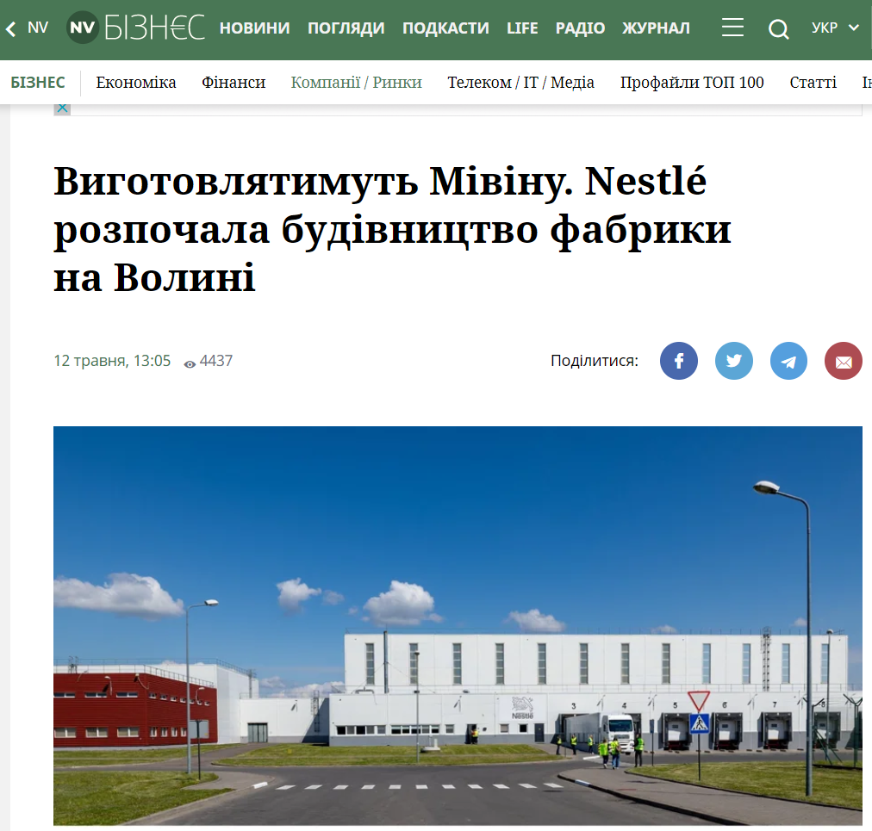
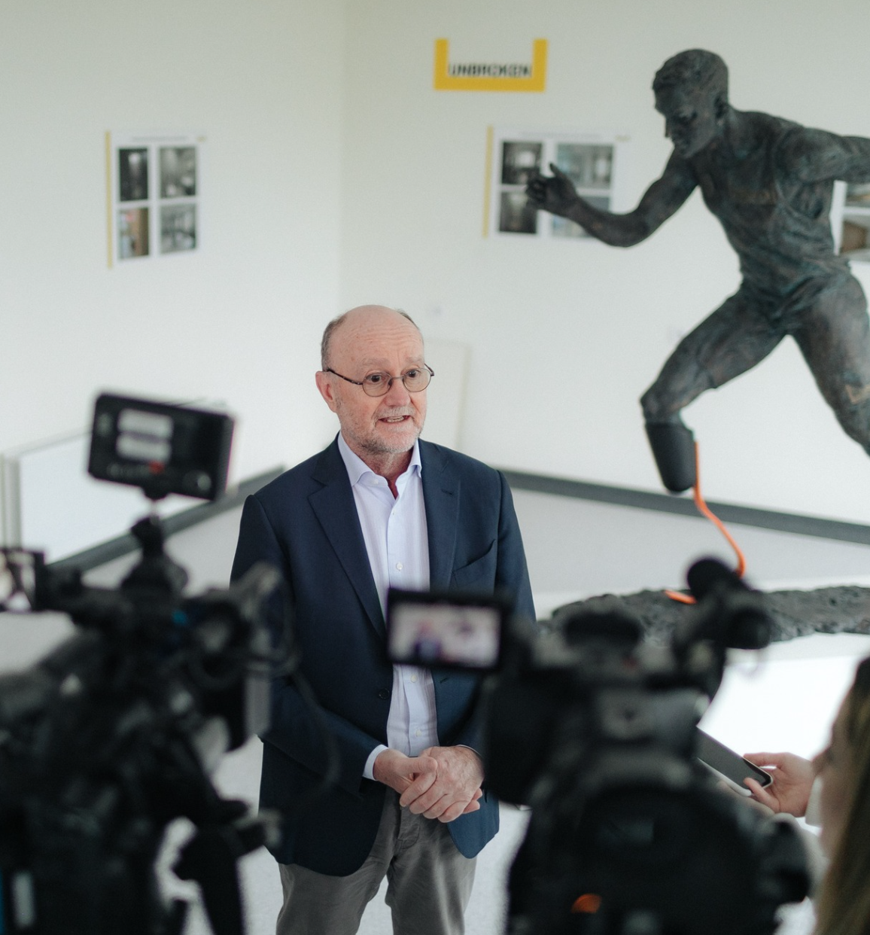
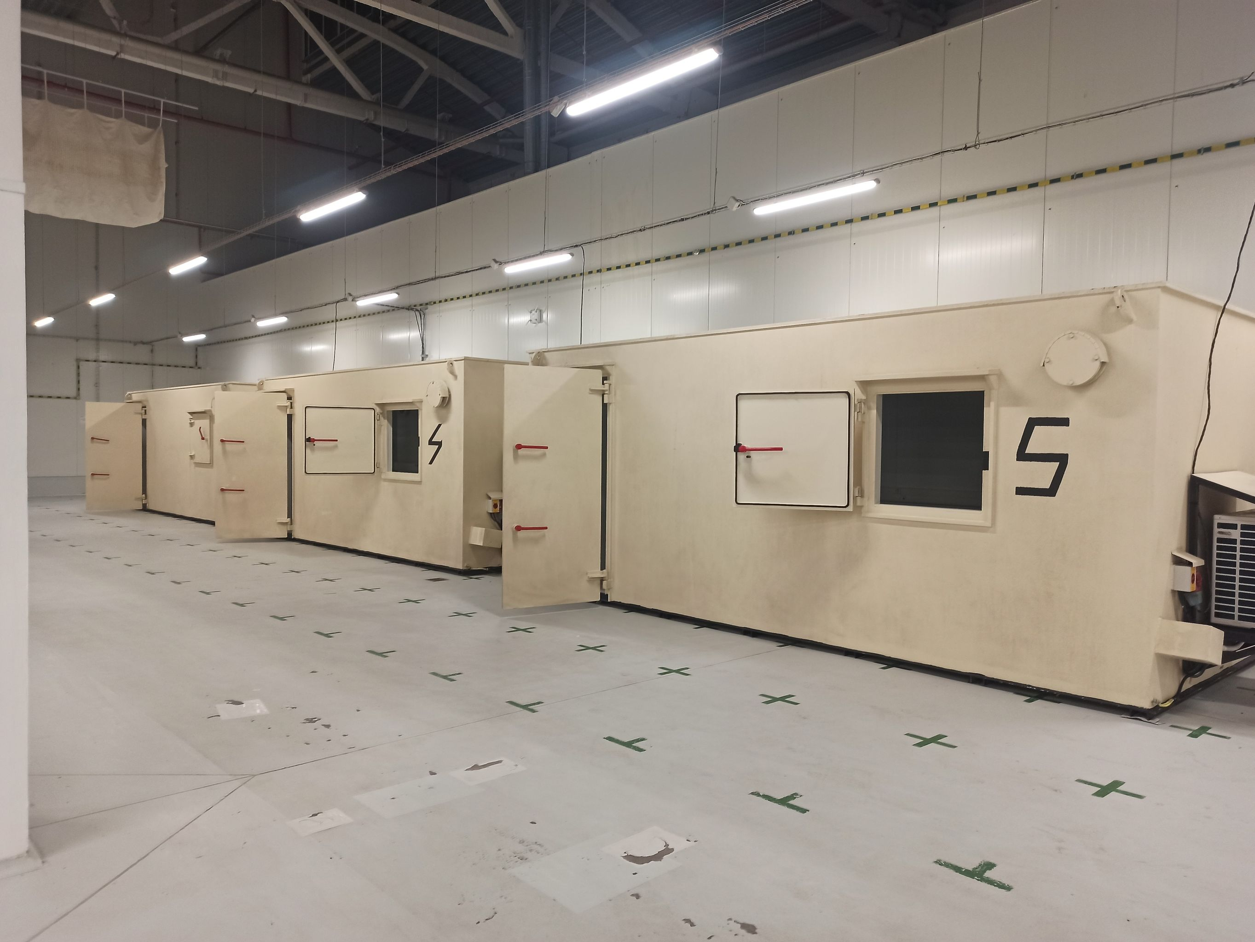
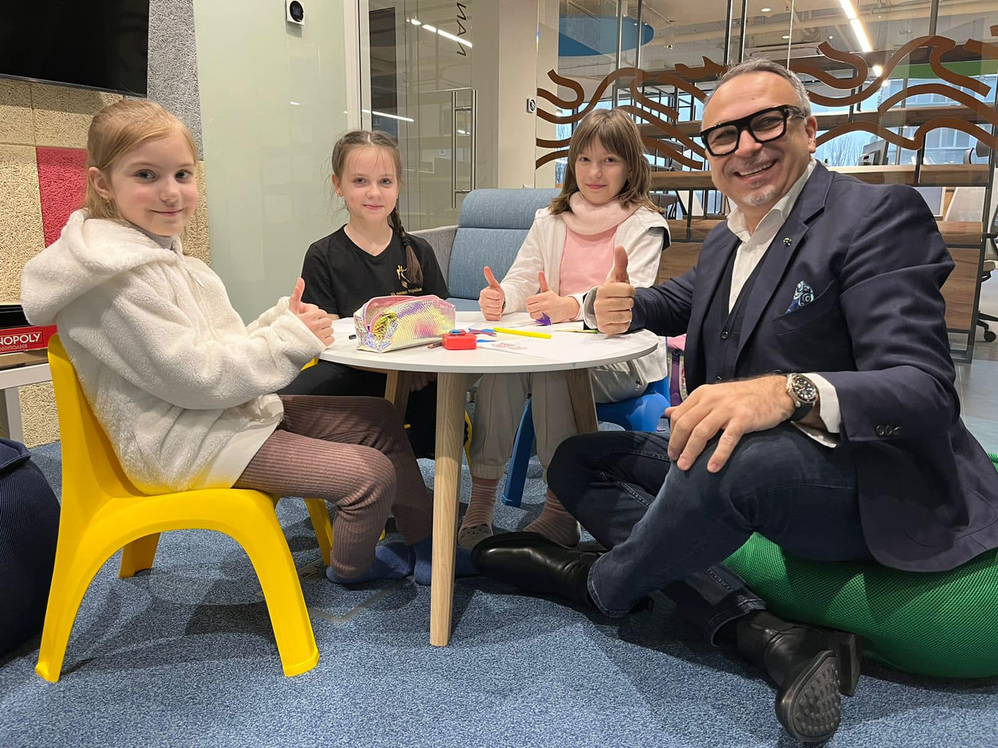
Re-defined playbook of the Leadership priorities for Nestlé Ukraine
Focus on Physical, Financial and Mental safety
Keep business continuity, Safeguard Assets
Support Ukraine & Ukrainians
Be a Force for Good

Slide 10
War makes us better
Daring leaders
Bravery
Resilience
Focusing
Creativity
Adaptiveness
Caring of people
Physical Safety
I am safe
Financial Safety
This meets my needs
Mental health
How are you?

